Slide 1
Java程式設計第一類接觸
臺北市立大學 資訊科學系(含碩士班)
賴阿福
laiahfur@gmail.com
CS TEAM

Slide 2
如何將高階語言轉換(翻譯;解譯;編譯;translate)為機械語言?
語法錯誤
Library
編輯
(edit)
工具
editor
來源碼source code
編譯
(compile)
compiler
目的碼object code
Link
Linker
載入
(Load)
Loader
可執行碼executable code
ROM
CPU
PC: Program counter
PC
main()
RAM
Main memory

Slide 3
Java電腦語言歷史
Java (爪哇島) is an island of Indonesia.
Java is a general-purpose computer programming language that is concurrent, class-based, object-oriented, and specifically designed to have as few implementation dependencies as possible.
It is intended to let application developers “write once, run anywhere” (WORA), meaning that compiled Java code can run on all platforms that support Java without the need for recompilation.
Java applications are typically compiled to bytecode that can run on any Java virtual machine (JVM) regardless of computer architecture (X86, MIPS, ARM....).
Java was originally developed by James Gosling at Sun Microsystems (which has since been acquired by Oracle Corporation) and released in 1995 as a core component of Sun Microsystems' Java platform.
James Gosling, Mike Sheridan, and Patrick Naughton initiated the Java language project in June 1991.
The language derives much of its syntax from C and C++, but it has fewer low-level facilities than either of them.
The original and reference implementation Java compilers, virtual machines, and class libraries were originally released by Sun under proprietary licenses. As of May 2007, in compliance with the specifications of the Java Community Process, Sun relicensed most of its Java technologies under the GNU General Public License. Others have also developed alternative implementations of these Sun technologies, such as the GNU Compiler for Java (bytecode compiler), GNU Classpath (standard libraries), and IcedTea-Web (browser plugin for applets).
Java was originally designed for interactive television, but it was too advanced for the digital cable television industry at the time. The language was initially called Oak after an oak tree that stood outside Gosling's office. Later the project went by the name Green and was finally renamed Java, from Java coffee. Gosling designed Java with a C/C++-style syntax that system and application programmers would find familiar.
Sun Microsystems (昇陽公司) released the first public implementation as Java 1.0 in 1995. The latest version is Java 8 which is the only version currently supported for free by Oracle (甲骨文公司) .
資料來源 https://en.wikipedia.org/wiki/Java_(programming_language)

Slide 4
如何將java語言轉換(翻譯;解譯;編譯;translate)為bytecode?
執行
CPU
DEBUG
Library
JAVA VIRTUAL MACHINE FOR MS
x86
語法錯誤
編輯
(edit)
工具
editor
來源碼source code
編譯
(compile)
compiler
位元組碼
byte code
JAVA VIRTUAL MACHINE FOR iOS
POWER pc
.class
.java
JAVA VIRTUAL MACHINE FOR UNIX
Arm
位元組碼byte code :
虛擬機械碼(PSUEDO CODE)，需透過java解譯程式才能執行
write once, run anywhere
跨平台程式語言

Slide 5
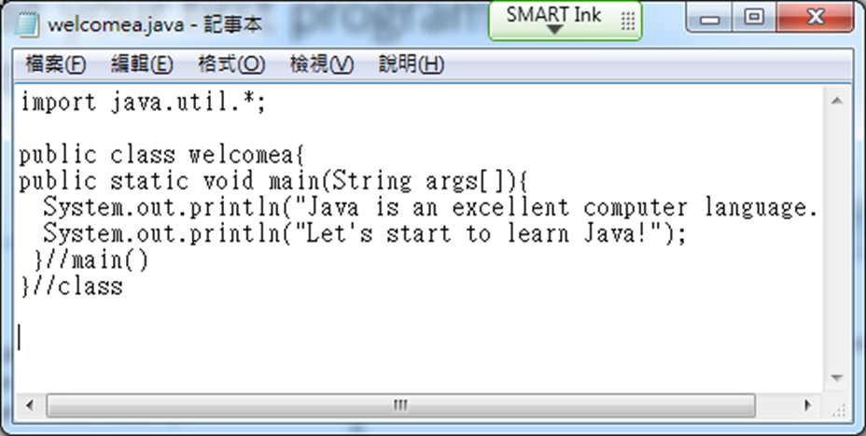
語言?電腦語言?
語法: 規則、結構 (限制)
語句: statement
語意: 解決方法 (演算法)

Slide 6
學習程式之觀念
漸進式學習
From unclear to clear
不用全部學完語法再開始程式設計
  不可能一步登天
從基本功能進化、優化
養成規劃、設計習慣
不要怕出現Bug
思考、動手寫程式

Slide 7
撰寫java程式三部曲
編輯(edit):如用記事本編寫
編譯(compile)
  如果編譯未完成(有錯誤:bug, error)
    除錯(debug): 找出錯誤，修正
    重新編譯
  如果編譯完成,產出 .class
執行 (run, execute) :如果編譯完成沒錯誤

Slide 8
你的第一支java程式

Slide 9
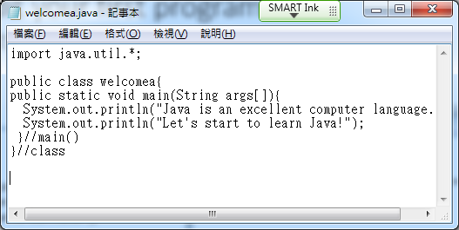
How to edit your first java program?
新增”資料夾”存放java程式檔，自己為資料夾取名字(如afjava)
開啟記事本軟體
輸入第一個程式或由酷課雲下載welcomea.java至自己資料夾(如afjava)
以類別名稱存檔，副檔名為java
import java.util.*;
public class welcomea{
public static void main(String args[]){
System.out.println("Java is an excellent computer language.");
System.out.println("Let's start to learn Java!");
}//main()
}//class

Slide 10
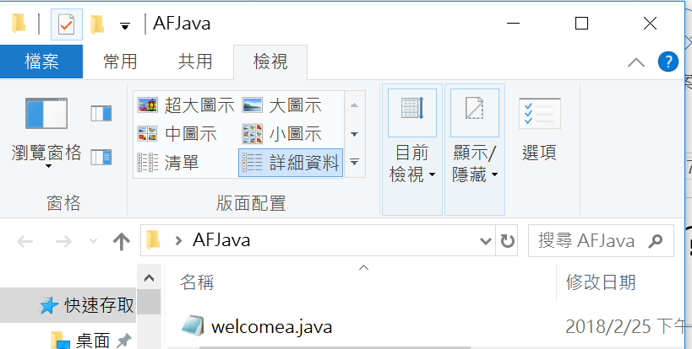
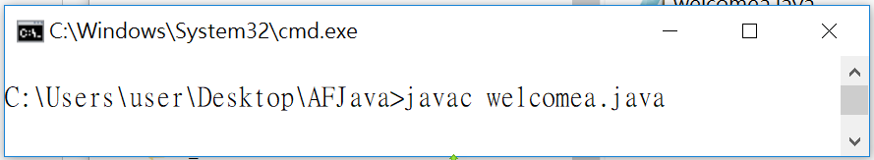
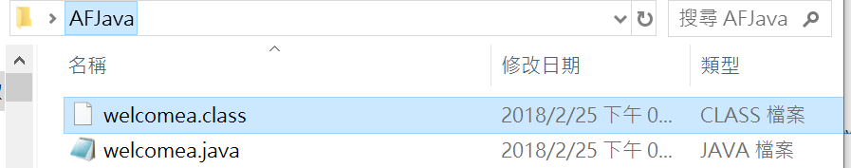
How to compile your first program?
進入cmd編譯程式:
command line環境
(MS DOS)
查看結果:
產出.class
cmd

Slide 11

How to run your first program?執行
錯誤
  Java welcomea.class
正確
  Java welcomea

Slide 12
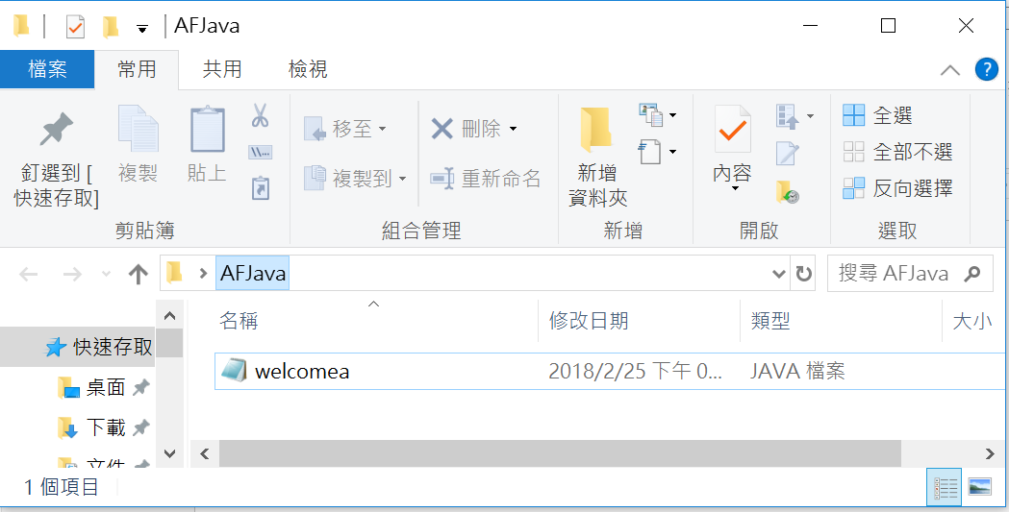
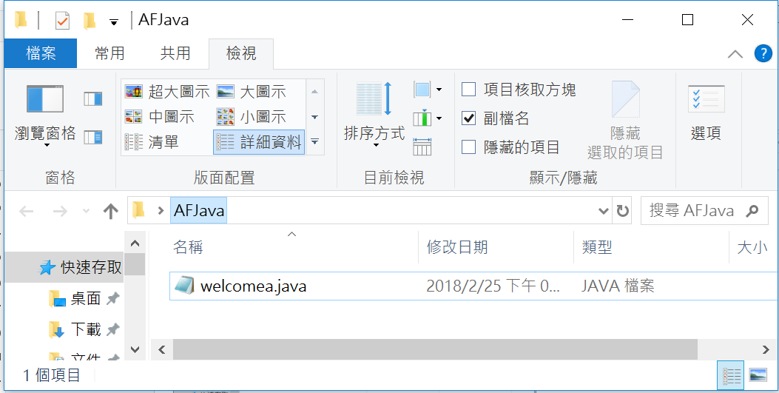
副檔名未出現,how to do?

Slide 13
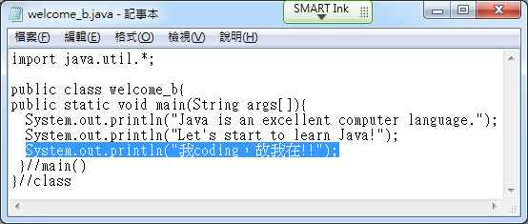
開始練習!
仿作:EDIT, COMPILE, RUN
修改: 增加一行輸出，如

Slide 14
程式回顧
import java.util.*; //匯入函數庫
public class welcomea{
public static void main(String args[]){ //主程式名稱固定
//主程式body
}//main()結尾
}//class結尾
Class body

Slide 15
仔細研究程式
import java.util.*; //匯入函數庫
public class welcomea{
public static void main(String args[]){
System.out.println(“Java is an excellent computer language.”);//輸出
System.out.println("Let's start to learn Java!");
}//main()
}//class

Slide 16
程式概念
Java是物件導向(OOP)語言，因此在設計都須將程式視為物件之類別(class)，給予類別名稱(class name)，且類別名稱一定是主檔案名稱(主檔名)，副檔名一定是java。
類別名稱如何命名?
  以英文字開頭，取有意義名稱，勿用中文
Java程式由許多函數/方法(function/method)所組成，函數是由許多敘述或指令所組成。

Slide 17
程式概念
CPU如何知道開始要執行哪一函數?CPU很笨!
  因此須規定開始執行的函數(entry point)，那就是main，main即為主函數。
大部分電腦都不是自然語言，因此會先規定一些字彙做為特殊功能，即保留字(reserved word)，這些字有特殊用途，不可任意使用
  class, public, static, void
區分大小寫(case sensitive):各種名稱、保留字
. :class/object存取符號，”的”
“ ”: 字串常數
// :註解(comment), 說明用，不是指令，編譯時會被忽略

Slide 18
習題2-1:編輯你的第一支java程式，完成java程式三部曲
為你的第一支java程式取名字，如AF_first.java
  名字規則:英文字開頭、區分大小寫、第二字元後可用數字_，但不可用+-*/
輸出敘述至少四行，寫出第一支java程式感受，中英文不限
  System.out.println(“ !");
上傳作業(.java及執行畫面截圖放.docx)至酷課雲
import java.util.*; //匯入函數庫
public class AF_first {
public static void main(String args[]){
System.out.println(“”);//輸出
System.out.println("");
System.out.println("");
System.out.println("");
}//main()
}//class

Slide 19
Debug抓錯蟲
mport java.util.*; /匯入函數庫
public class 9welcomex{
public static void Main(String args[]){
system.Out.println(“Java is an excellent computer language.’’);/輸出
system.Out.println(‘Let's start to learn Java!’)
}/main()
}/class

Slide 20
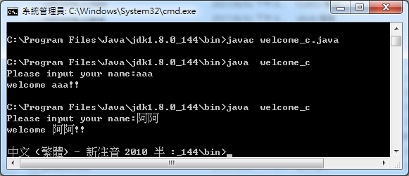
Second program
import java.util.*;
public class welcome_c{
public static void main(String args[]){
System.out.print("Please input your name:");
Scanner sca = new Scanner(System.in);//產生Scanner物件, 提供鍵盤輸入
String name = sca.next();
System.out.println("welcome "+name+"!!");
}//main()
}//class

Slide 21
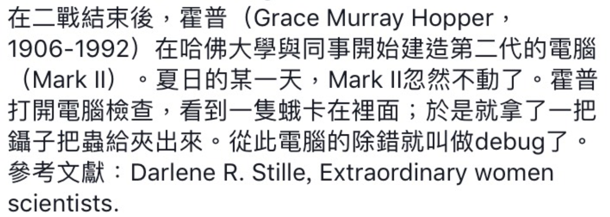
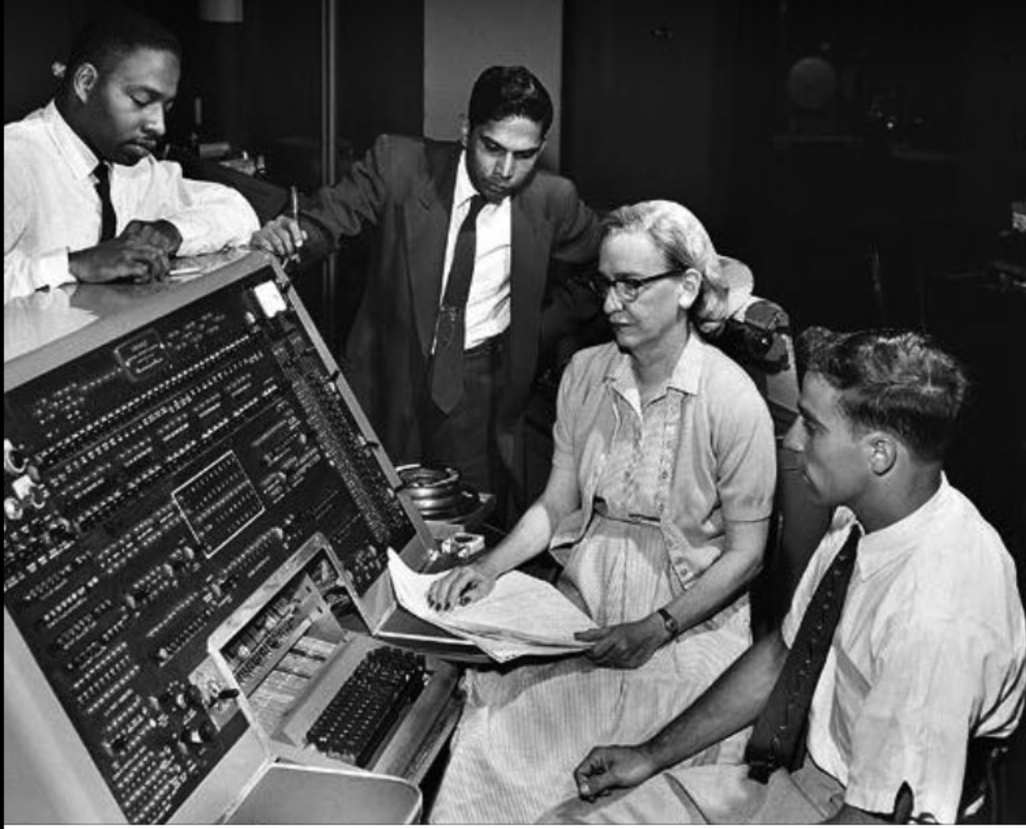
Debug(偵錯)之由來

Slide 22
何謂偵(抓)錯(debug)?語法(syntax)˴語意(semantic)錯誤?
何謂執行程式?
作業系統之Loader程式負責載入RAM,再交給CPU執行
為何需要Library函式庫?
  站在巨人肩膀,有些程式細節非常複雜如Input/Output、圖形之細部工作,因此必須提供系統函數提供設計者直接引用.
語法(syntax)錯誤?
  指的是句子文法上的錯誤,ie:我是學生 → 我學生是
  Compiler可抓到語法錯誤
語意(semantic)錯誤?
  指的是句子意思上的錯誤,ie:我是學生 → 我不是學生
  Compiler抓不到語意錯誤

